Slide 1
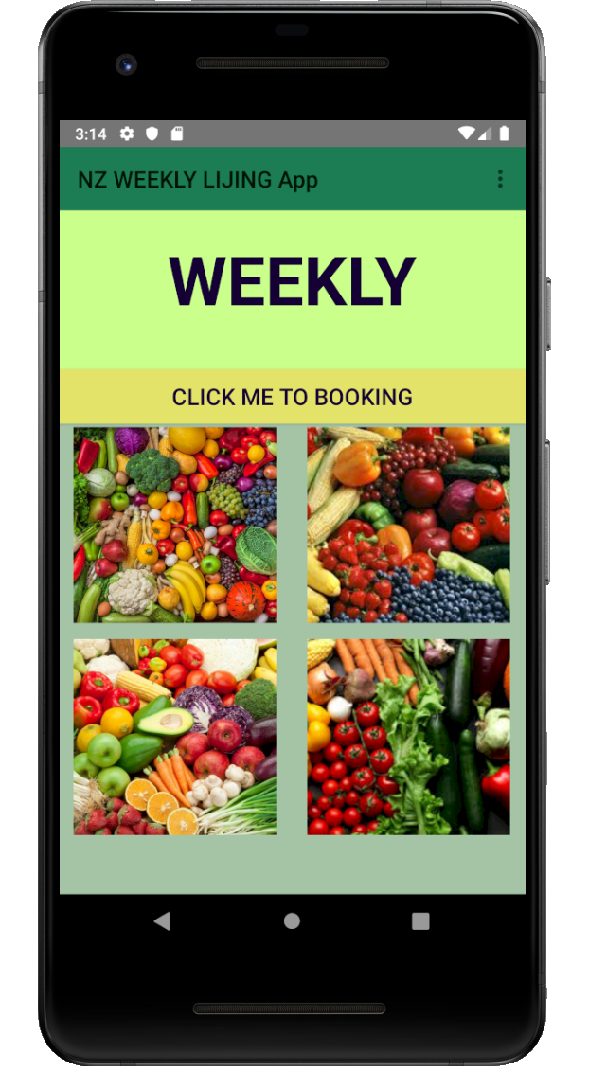
Weekly Fruit LIJING APP
Jing Li Student ID:21902204

Slide 2
Structure
App Objectives
Design Framework
Technical Methodology
Video Demo

Slide 3
App Objectives
My App can help some customers to order the weekly fruit packages from a platform.
Real time : It solves the problem of older system only access by email ,it was really inconvenient for the real time operation.
Picture content : It also solves the older system problem that can’t be able to wander every week fruit packages in advance.
Convenience : It is helpful to management by Mobile App for the boss.

Slide 4
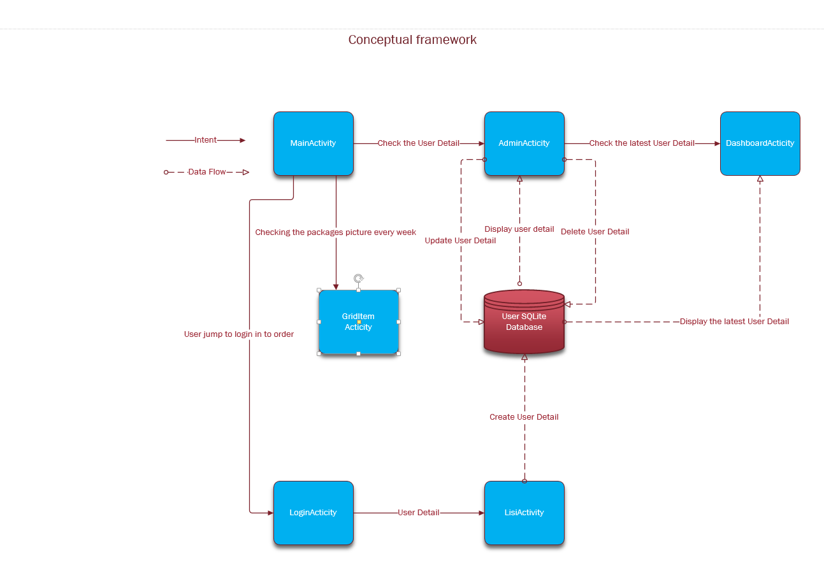

Slide 5
Technical Methodology Main functions:
Design layout of different Activity to complish the order process.
SQLite Database implementation and management(CRUD functions_DbHandler) have made the App become a better product to use , User can manage the order information and CRUD in one phone .
Toolbar-NavigationDrawer
GridView and GridItemView
Basic Methodologies like Intent , Input, Adapter, Toolbar, Menu,UI Test etc.

Slide 6
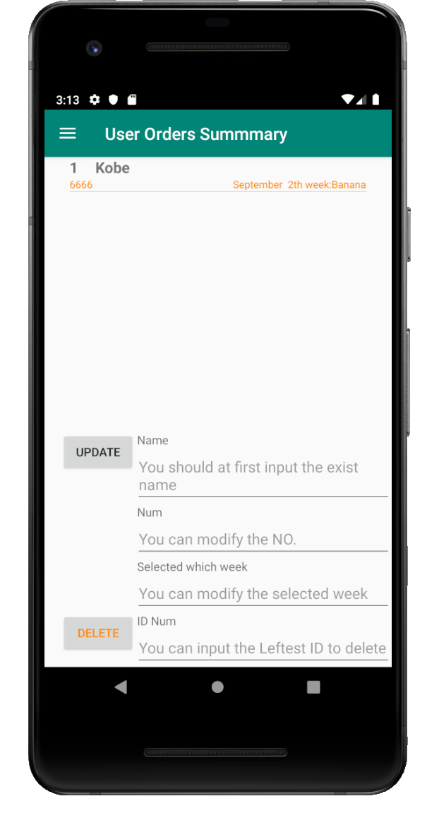
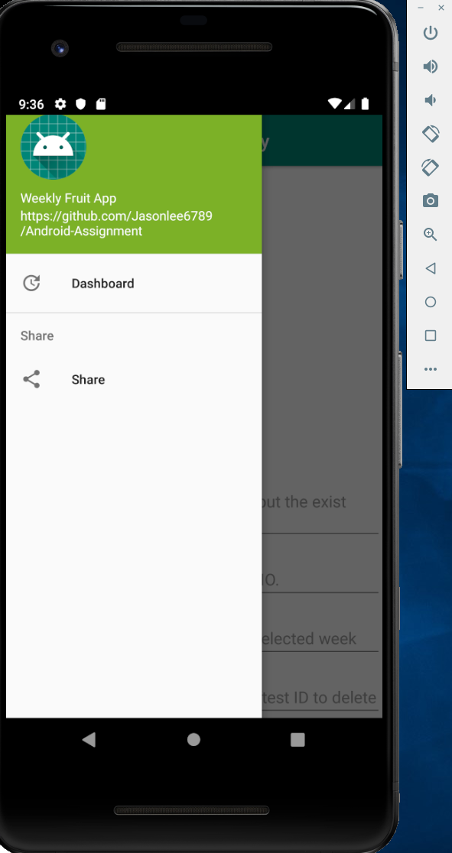
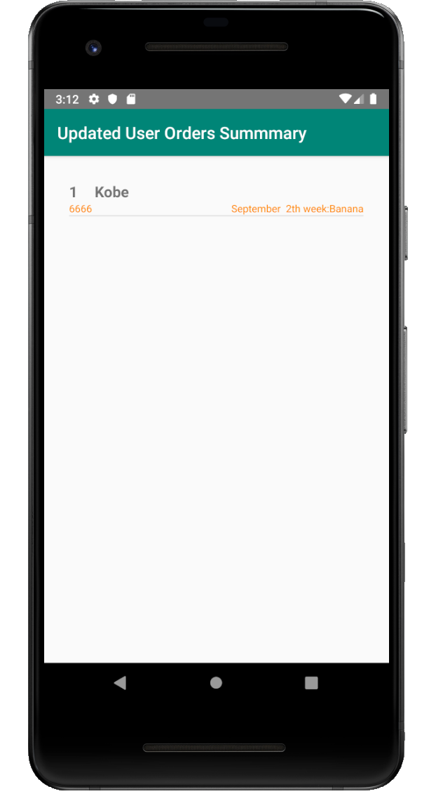
Toolbar-NavigationDrawer

Slide 7
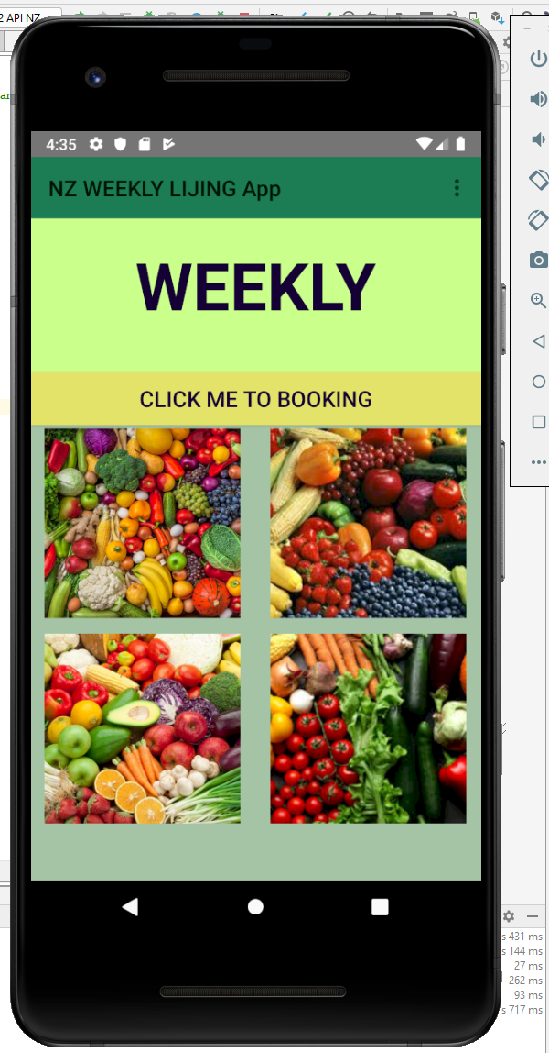
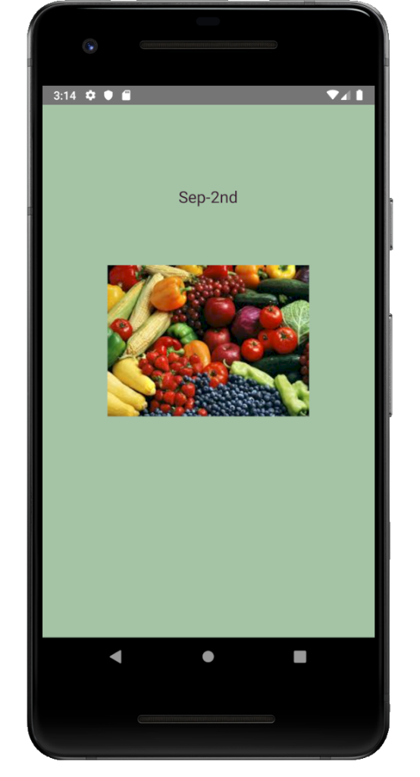
GridView and GridItemView

Slide 8
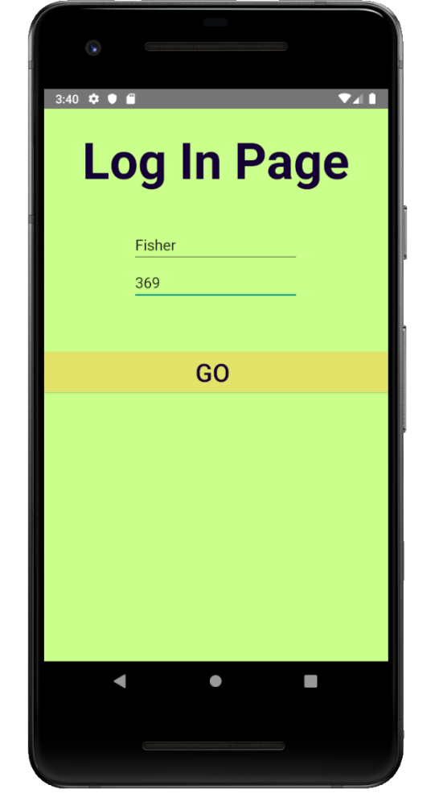
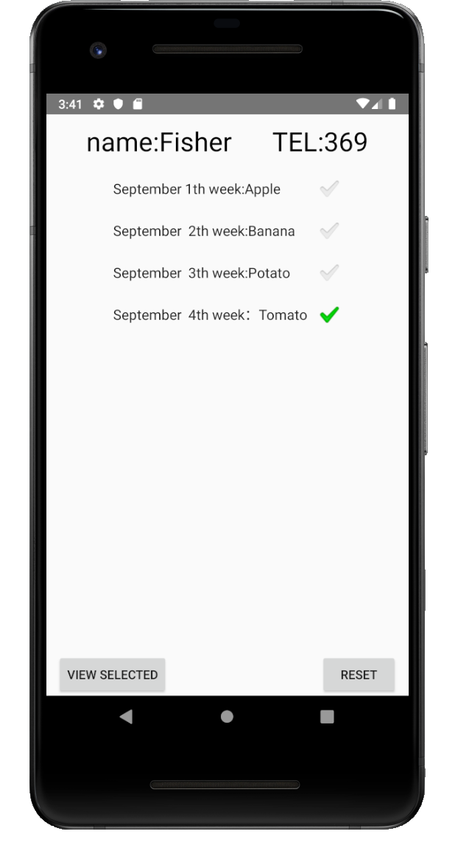
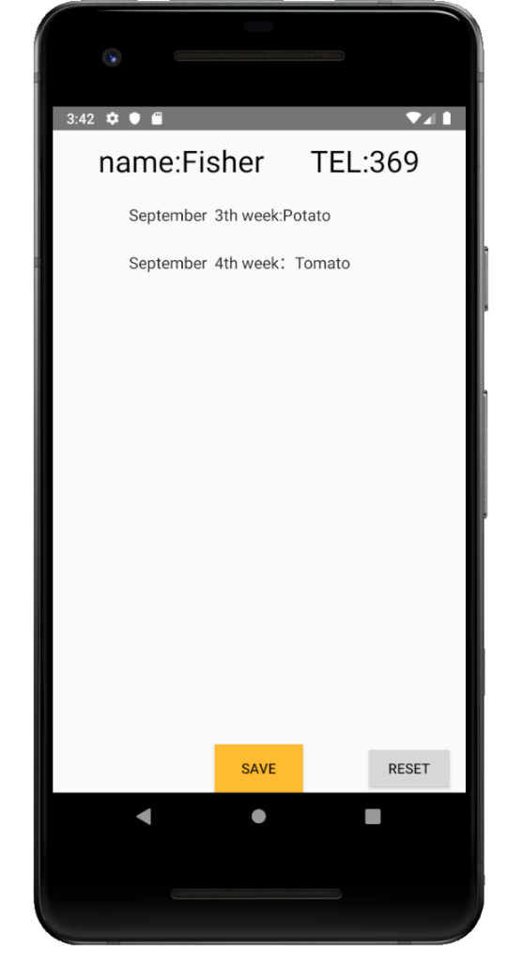
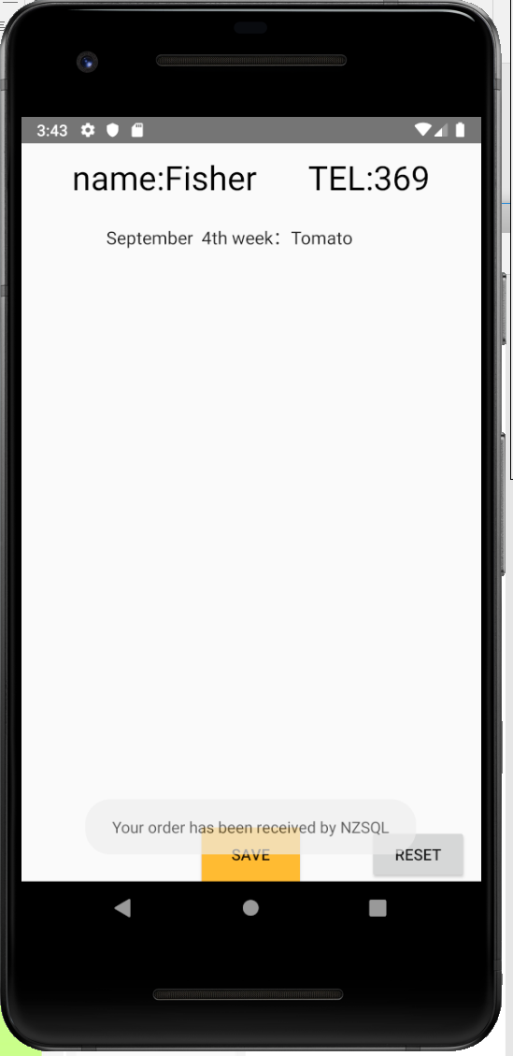
Order process(SQLite Database Create)

Slide 9
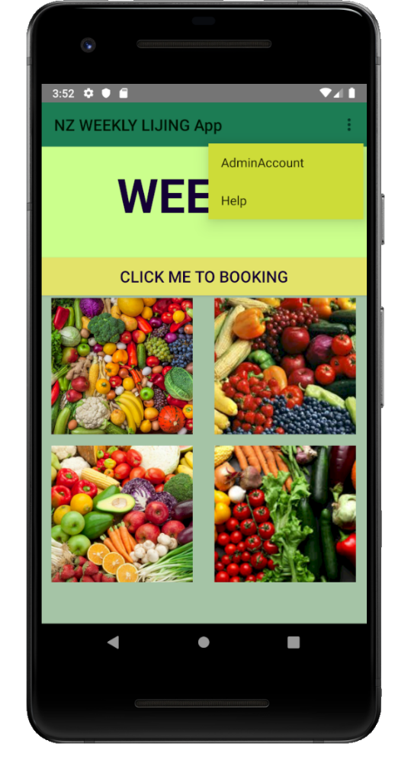
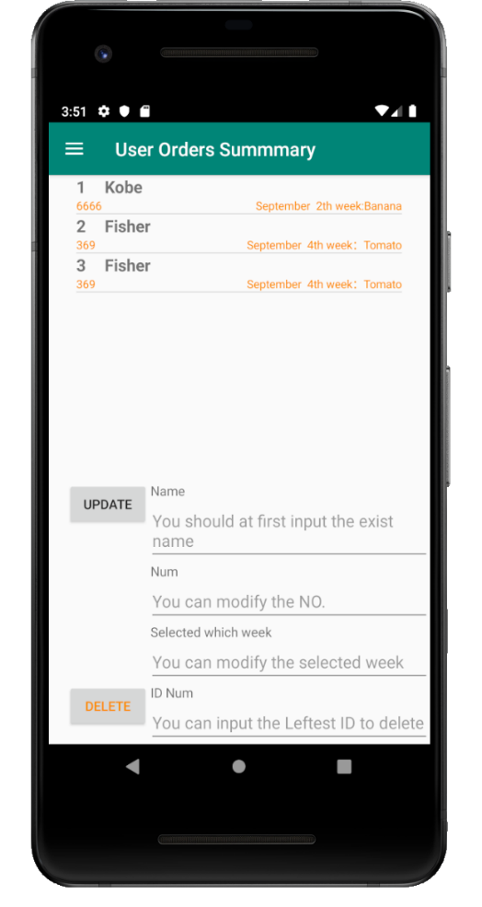
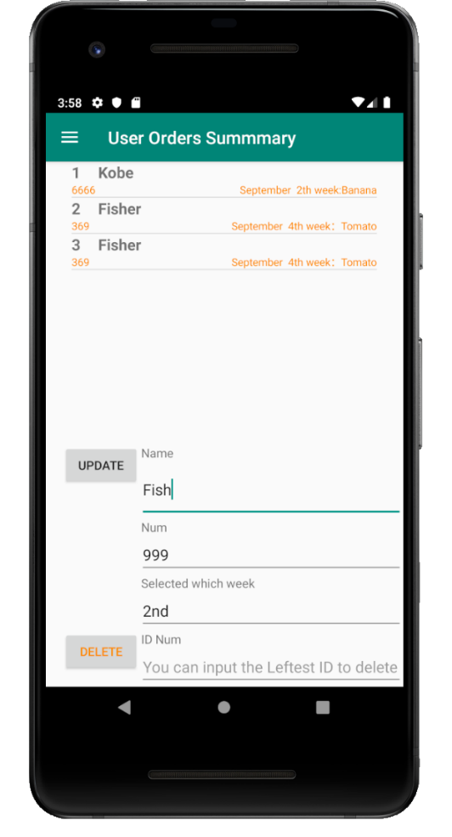
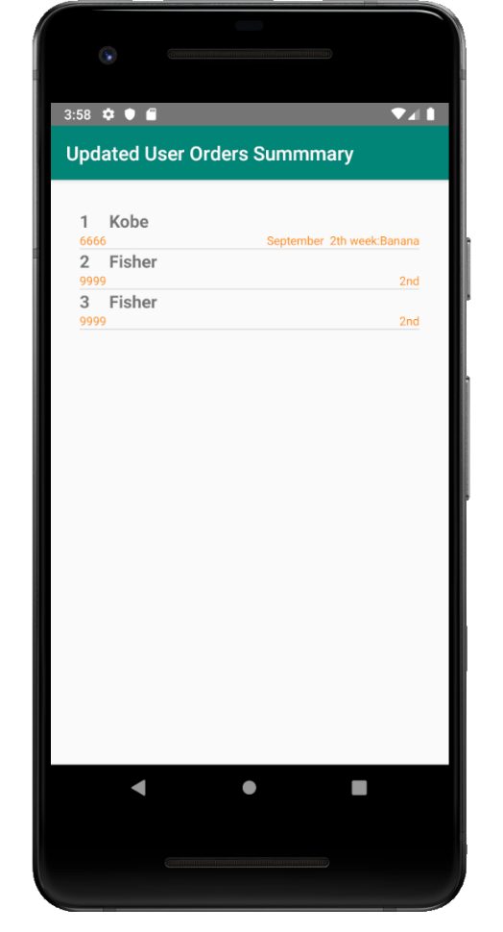
SQLite Database implementation and management(Read-Update-functions)

Slide 10

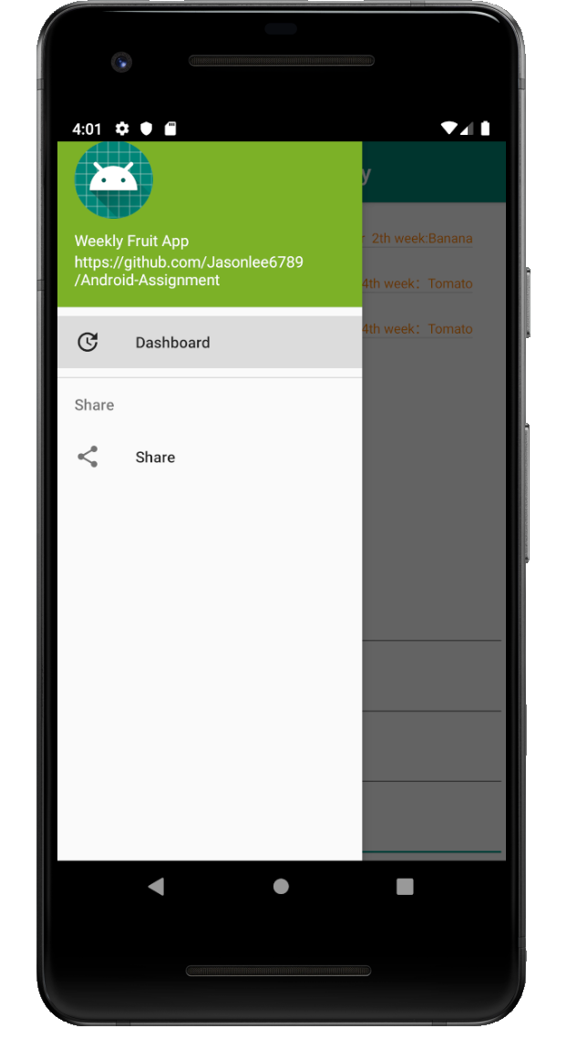
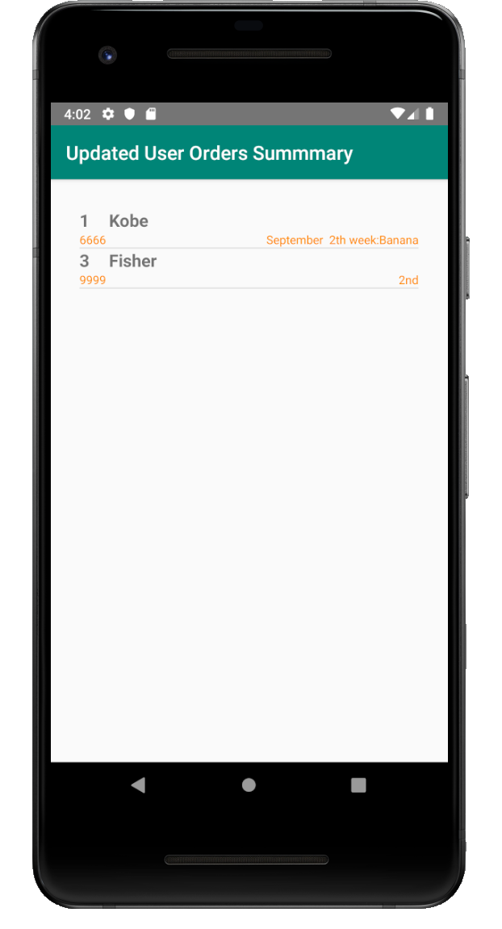
SQLite Database Delete

Slide 11
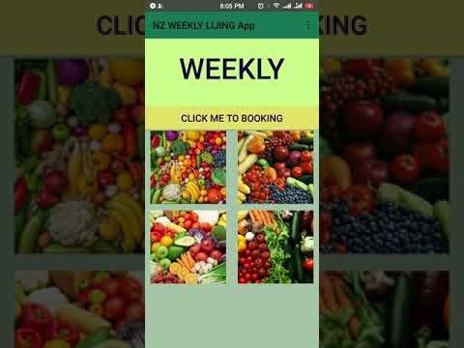
Video

